Slide 1
ELECTRIC CHARGES

Slide 2
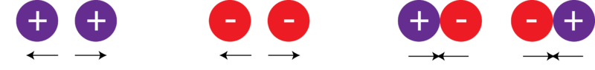
ELECTRIC CHARGES

Slide 3
OBJECTIVES
Explain the process of charging materials
Solve problems using Coulomb’s law

Slide 4
ELECTRICITY
Electricity is a phenomenon associated with stationary or moving electric charges.
Electric and magnetic effects are caused by the relative positions and movements of charged particles of matter. When a charge is stationary (static), it produces electrostatic forces on charged objects, and when it is in motion it produces additional magnetic effects.

Slide 5
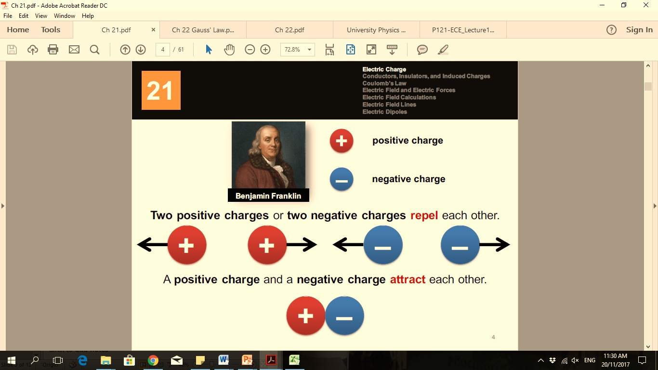
ELECTRIC CHARGE
Electric charge is an intrinsic property of matter that occurs in discrete natural units and is neither created nor destroyed.
Unit of electric charge is coulombs, C.
Electric charges are of two general types:
Electric charge is a quantity of electricity

Slide 6
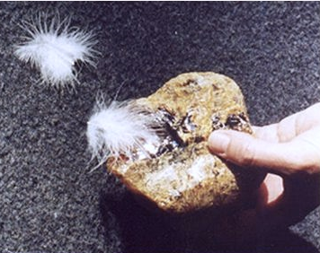
ELECTRIC CHARGE
As early as 600 B.C., ancient Greeks rubbed amber with wool. Amber becomes negatively charged while wool becomes positively charged.
The amber could attract other objects
At present, amber has acquired a net electric charge or has become charged
“Electric”
- Derived from Greek word elektron, meaning amber

Slide 7
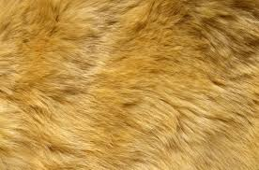
ELECTRIC CHARGE
Plastic and Fur
Before Rubbing
After Rubbing
–
–
–
+
+
+
–
–
+
+
+
–
Plastic
Fur
Plastic
Fur

Slide 8
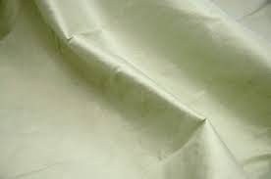
ELECTRIC CHARGE
Glass and Silk
Before Rubbing
After Rubbing
+
+
+
–
–
–
+
+
–
–
–
+
Glass
Silk
Glass
Silk

Slide 9
ELECTRIC CHARGE
Attraction and repulsion of rods after rubbing
Plastic
Plastic
Glass
Glass
Glass
Plastic
–
–
+
+
+
–
–
–
+
+
+
–
–
–
–
–
+
+
+
–
–
+
+
+
–
–
+
+
–
–
+
–
+
+
+
–
Repel
Repel
Attract

Slide 10
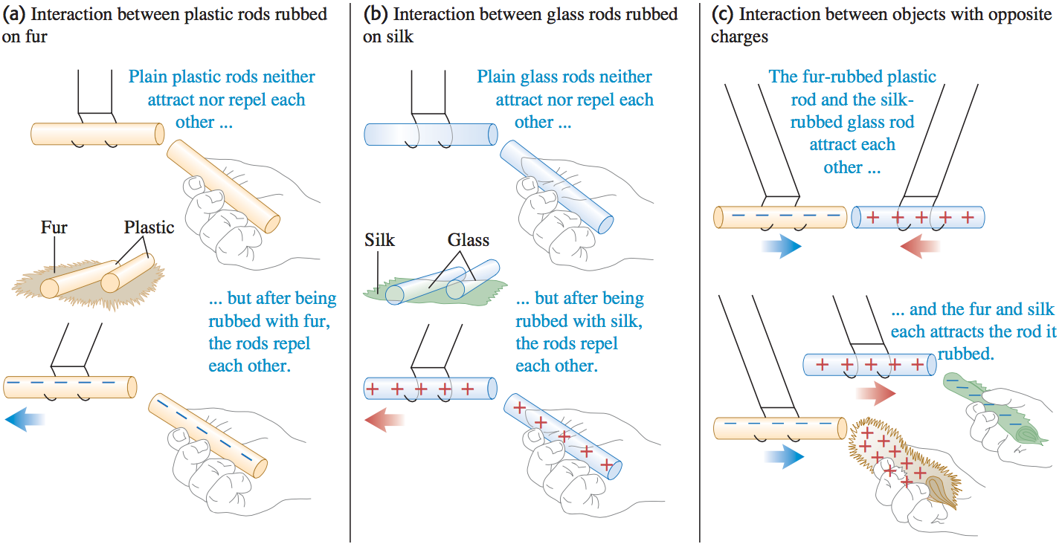
ELECTRIC CHARGE

Slide 11
ELECTRIC CHARGE

Slide 12
LAW OF CONSERVATION OF ELECTRIC CHARGE
the net amount of electric charge produced in any process is zero
or
no net charge can be created or destroyed
If one object acquires a positive charge, then an equal amount of negative charge will be found in neighboring areas or objects.

Slide 13
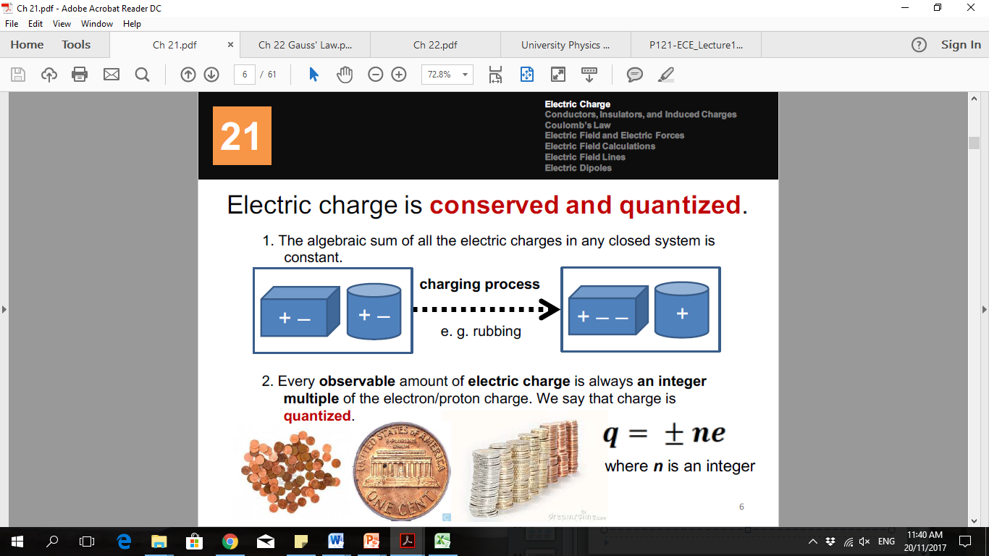
LAW OF CONSERVATION OF ELECTRIC CHARGE
The algebraic sum of all electric charges in any closed system is constant
The magnitude of charge of the electron or proton is a natural unit of charge

Slide 14
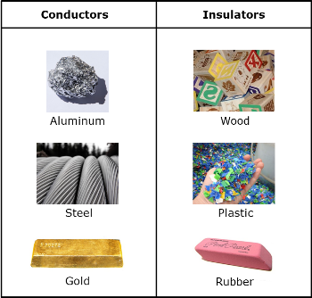
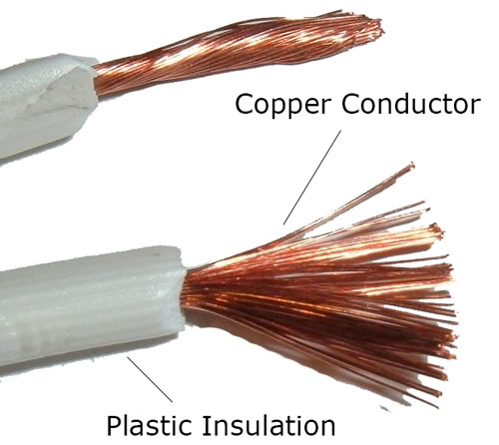
CONDUCTORS AND INSULATORS
Conductors
- materials that allow electric current to pass through
Insulators
- materials that does not allow electric current to pass through

Slide 15
CHARGING PROCESS
Matters can be charged in some ways:
charging by contact
charging by induction
Conduction charging engage the contact of a charged object to a neutral object.
Induction charging is a method used to charge an object without touching the object to any other charged object.
Charging means gaining or losing electron.
Notes:
https://www.eeweb.com/profile/andrew-carter/articles/charging-by-contact-and-induction

Slide 16
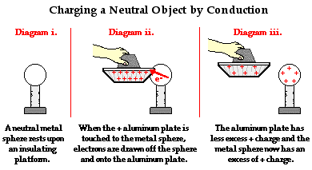
CHARGING PROCESS
Charging by CONDUCTION using a positively charged object
Notes:
https://www.physicsclassroom.com/class/estatics/Lesson-2/Charging-by-Conduction

Slide 17
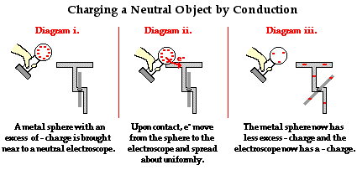
CHARGING PROCESS
Charging by CONDUCTION using a negatively charged object
https://www.physicsclassroom.com/class/estatics/Lesson-2/Charging-by-Conduction
Notes:
https://www.physicsclassroom.com/class/estatics/Lesson-2/Charging-by-Conduction

Slide 18
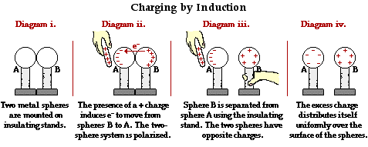
CHARGING PROCESS
Charging by INDUCTION using a positively charged object
Video: Charging by Induction
https://www.askiitians.com/iit-jee-electrostatics/charging-by-induction/
Notes:
https://www.askiitians.com/iit-jee-electrostatics/charging-by-induction/
Video: https://www.youtube.com/watch?v=ZvJKdBS-Z4g

Slide 19
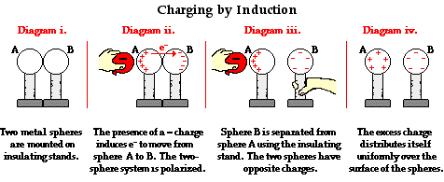
CHARGING PROCESS
Charging by INDUCTION using a negatively charged object
Video: Charging by Induction
Notes:
https://www.askiitians.com/iit-jee-electrostatics/charging-by-induction/
Video: https://www.youtube.com/watch?v=ZvJKdBS-Z4g

Slide 20
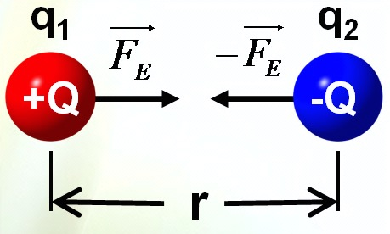
COULOMB’S LAW
The magnitude of the electric force F between two point charges is directly proportional to the product of the charges and inversely proportional to the square of the distance between them.
Where
F = repulsive or attractive force (N)
k = proportionality constant
k = 9 x 10⁹ Nm²/C²
q₁ = charge of point charge 1 (C)
q2 = charge of point charge 2 (C)
r = distance between the 2 objects (m)
The direction of the electric force is always along the line joining the 2 objects. It depends whether the charges have the same or opposite signs

Slide 21
COULOMB’S LAW
Two point charges have a Coulomb force of magnitude F. If the distance between them is tripled, what will be the magnitude of the new force?
Notes:
What if the distance was kept constant, but one of the charges was doubled?

Slide 22
COULOMB’S LAW
For more than two particles, use the principle of superposition
Vector addition
Electric force is stronger than gravitational force at the atomic scale.

Slide 23
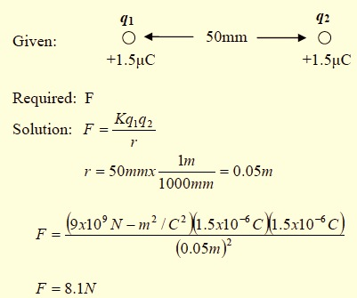
COULOMB’S LAW
Find the magnitude of the force between two charges of 1.5μC each that are 50mm apart.
²

Slide 24
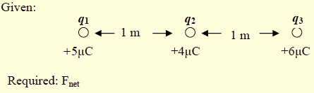
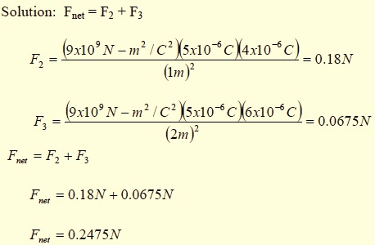
COULOMB’S LAW
Three charges: q₁ = 5μC, q₂ = 4μC and q₃ = 6μC are lying along a straight line. q₁ is one meter away from q₂ and q₂ is one meter away from q₃. Find the net electric force on q₁.
F₁₂: To the left
F₁₃: To the left

Slide 25
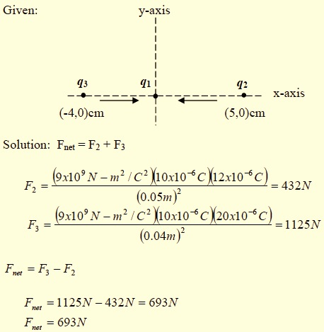
COULOMB’S LAW
Point charge q₁ = 10μC, is placed at the origin of the Cartesian coordinate system. Another point charge q₂ = 12μC is placed at (5,0)cm and q₃ = 20μC is placed at (-4,0)cm. Find the net force on q₁.
F₁₂: To the left
F₁₃: To the right
q₃ = 20μC
q₂ = 12μC
q₁ = 10μC

Slide 26
SEATWORK
Two point charges have a Coulomb force of magnitude of 5N. If distance r is halved, what will be the magnitude of the new force?
Find the magnitude of the force between two charges (q₁=1.5μC and q₂=2.5μC) which are 2cm apart.

Slide 27
SEATWORK
3. Point charge q₁ = 5μC, is placed at the origin of the Cartesian coordinate system. Another point charge q₂ = 6μC is placed at (0,6)cm and q₃ = 10μC is placed at (0,-4)cm. Find the net force on q₁.

Slide 28
ASK ANY QUESTION RELATED TO OUR TOPIC FOR TODAY.

Slide 29
Thank you for listening…

